Slide 1
Operationalise your Kubernetes cluster with Azure
Bruno Faria

Slide 2



Bruno Faria
MVP Reconnect @ 2018
Principal Consultant C&I @ Insight
Azure Advocate
Azure Compute IaaS and PaaS
Automation
DevOps
brunofaria
bnlf
nunes@outlook.com

Slide 3
Agenda
Overview
What is Kubernetes
Components
Objects
Configuration
AKS Cluster Architecture
AKS Nodes and Pods
Demo

Slide 4
Kubernetes Overview

Slide 5
What is Kubernetes?
Why do I need it?
What I can do with it?
Why Containers?
What does Kubernetes mean?
Notes:
Kubernetes has a number of features. It can be thought of as:
a container platform
a microservices platform
a portable cloud platform and a lot more
Kubernetes provides a container-centric management environment. It orchestrates computing, networking, and storage infrastructure on behalf of user workloads. This provides much of the simplicity of Platform as a Service (PaaS) with the flexibility of Infrastructure as a Service (IaaS), and enables portability across infrastructure providers
While Docker provided an open standard for packaging and distributing containerized applications, there arose a new problem. How would all of these containers be coordinated and scheduled? How do all the different containers in your application communicate with each other? How can container instances be scaled?
Solutions for orchestrating containers soon emerged. Kubernetes, Mesos, and Docker Swarm are some of the more popular options for providing an abstraction to make a cluster of machines behave like one big machine, which is vital in a large-scale environment.
Kubernetes is the container orchestrator that was developed at Google which has been donated to the CNCF and is now open source. It has the advantage of leveraging Google’s years of expertise in container management. It is a comprehensive system for automating deployment, scheduling and scaling of containerized applications, and supports many containerization tools such as Docker.
For now, Kubernetes is the market leader and the standardized means of orchestrating containers and deploying distributed applications. Kubernetes can be run on a public cloud service or on-premises, is highly modular, open source, and has a vibrant community.
Kubernetes provides a container-centric management environment. It orchestrates computing, networking, and storage infrastructure on behalf of user workloads. This provides much of the simplicity of Platform as a Service (PaaS) with the flexibility of Infrastructure as a Service (IaaS), and enables portability across infrastructure providers
The name Kubernetes originates from Greek, meaning helmsman or pilot, a person who steers a ship or boat. K8s is an abbreviation derived by replacing the 8 letters “ubernete” with “8”.

Slide 6
Kubernetes Components
Master
Kube-apiserver
Etcd
Kube-scheduler
Kube-controller-manager
Cloud-controller-manager
Node
Kubelet
Kube-proxy
Container runtime
Notes:
kube-apiserver
Component on the master that exposes the Kubernetes API. It is the front-end for the Kubernetes control plane.
It is designed to scale horizontally – that is, it scales by deploying more instances. See Building High-Availability Clusters.
etcd
Consistent and highly-available key value store used as Kubernetes’ backing store for all cluster data.
Always have a backup plan for etcd’s data for your Kubernetes cluster. For in-depth information on etcd, see etcd documentation.
kube-scheduler
Component on the master that watches newly created pods that have no node assigned, and selects a node for them to run on.
Factors taken into account for scheduling decisions include individual and collective resource requirements, hardware/software/policy constraints, affinity and anti-affinity specifications, data locality, inter-workload interference and deadlines.
Kube-controller-manager:
Component on the master that runs controllers.
Logically, each controller is a separate process, but to reduce complexity, they are all compiled into a single binary and run in a single process.
These controllers include:
Node Controller: Responsible for noticing and responding when nodes go down.
Replication Controller: Responsible for maintaining the correct number of pods for every replication controller object in the system.
Endpoints Controller: Populates the Endpoints object (that is, joins Services & Pods).
Service Account & Token Controllers: Create default accounts and API access tokens for new namespaces.
Cloud-controller-manager:
cloud-controller-manager runs controllers that interact with the underlying cloud providers.
The following controllers have cloud provider dependencies:
Node Controller: For checking the cloud provider to determine if a node has been deleted in the cloud after it stops responding
Route Controller: For setting up routes in the underlying cloud infrastructure
Service Controller: For creating, updating and deleting cloud provider load balancers
Volume Controller: For creating, attaching, and mounting volumes, and interacting with the cloud provider to orchestrate volumes
Node:
Kubelet - An agent that runs on each node in the cluster. It makes sure that containers are running in a pod.
The kubelet takes a set of PodSpecs that are provided through various mechanisms and ensures that the containers described in those PodSpecs are running and healthy. The kubelet doesn’t manage containers which were not created by Kubernete
kube-proxy - enables the Kubernetes service abstraction by maintaining network rules on the host and performing connection forwarding.
Container runtime - is the software that is responsible for running containers. Kubernetes supports several runtimes: Docker, containerd, cri-o, rktlet and any implementation of the Kubernetes CRI (Container Runtime Interface)

Slide 7
Kubernetes Objects
Persistent entities in the Kubernetes system. Kubernetes uses these entities to represent the state of your cluster such as:
What containerized applications are running (and on which nodes)
The resources available to those applications
The policies around how those applications behave, such as restart policies, upgrades, and fault-tolerance
Notes:
A Kubernetes object is a “record of intent”–once you create the object, the Kubernetes system will constantly work to ensure that object exists. By creating an object, you’re effectively telling the Kubernetes system what you want your cluster’s workload to look like; this is your cluster’s desired state.
To work with Kubernetes objects–whether to create, modify, or delete them–you’ll need to use the Kubernetes API. When you use the kubectl command-line interface, for example, the CLI makes the necessary Kubernetes API calls for you. You can also use the Kubernetes API directly in your own programs using one of the Client Libraries

Slide 8
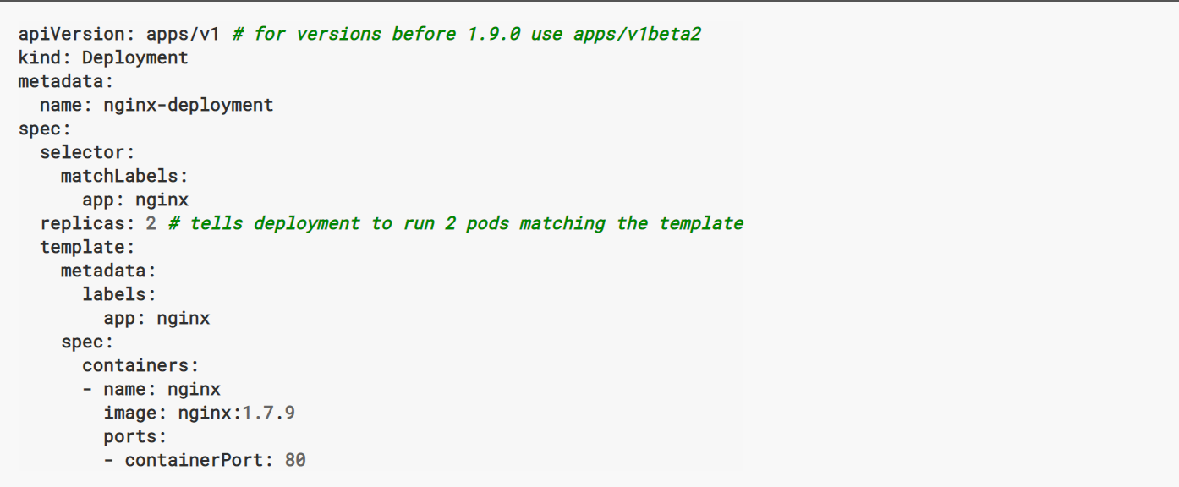
Kubernetes Objects
When you create an object in Kubernetes, you must provide the object spec that describes its desired state:
More info: https://kubernetes.io/docs/concepts/overview/working-with-objects/kubernetes-objects/

Slide 9
Kubernetes Configuration
All-in-One Single-Node Installation
Single-Node etcd, Single-Master, and Multi-Worker Installation
Single-Node etcd, Multi-Master, and Multi-Worker Installation
Multi-Node etcd, Multi-Master, and Multi-Worker Installation

Slide 10
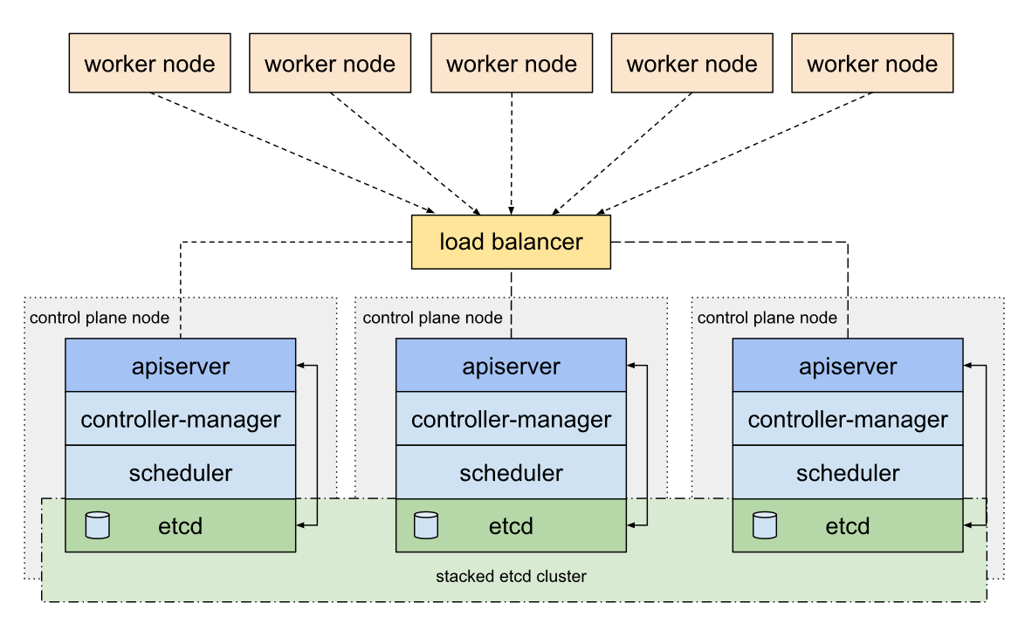
Kube HA - stacked etcd

Slide 11
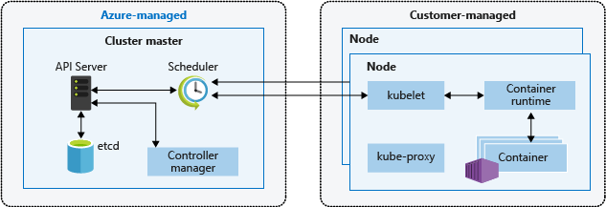
AKS Cluster Architecture
Single-tenant cluster master, with dedicated servers (API, Scheduler, etcd, Controller Mgr, etc.)
You define the number and size of the nodes, and the Azure platform configures the secure communication between the cluster master and nodes
Notes:
When you create an AKS cluster, a cluster master is automatically created and configured. This cluster master is provided as a managed Azure resource abstracted from the user. There is no cost for the cluster master, only the nodes that are part of the AKS cluster.
The cluster master includes the following core Kubernetes components:
kube-apiserver - The API server is how the underlying Kubernetes APIs are exposed. This component provides the interaction for management tools, such as kubectl or the Kubernetes dashboard.
etcd - To maintain the state of your Kubernetes cluster and configuration, the highly available etcd is a key value store within Kubernetes.
kube-scheduler - When you create or scale applications, the Scheduler determines what nodes can run the workload and starts them.
kube-controller-manager - The Controller Manager oversees a number of smaller Controllers that perform actions such as replicating pods and handling node operations.
AKS provides a single-tenant cluster master, with a dedicated API server, Scheduler, etc. You define the number and size of the nodes, and the Azure platform configures the secure communication between the cluster master and nodes. Interaction with the cluster master occurs through Kubernetes APIs, such as kubectl or the Kubernetes dashboard.
This managed cluster master means that you do not need to configure components like a highly available etcd store, but it also means that you cannot access the cluster master directly. Upgrades to Kubernetes are orchestrated through the Azure CLI or Azure portal, which upgrades the cluster master and then the nodes. To troubleshoot possible issues, you can review the cluster master logs through Azure Log Analytics.
If you need to configure the cluster master in a particular way or need direct access to them, you can deploy your own Kubernetes cluster using aks-engine.

Slide 12
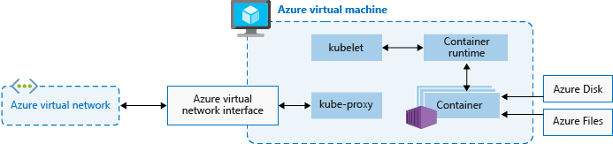
AKS Nodes and Node Pools
Processes orchestration requests
(Docker!) Allows containerized applications to run and interact with additional resources such as the virtual network and storage
Routes network traffic and manages IP addressing for services and pods
Notes:
To run your applications and supporting services, you need a Kubernetes node.
An AKS cluster has one or more nodes, which is an Azure virtual machine (VM) that runs the Kubernetes node components and container runtime:
The kubelet is the Kubernetes agent that processes the orchestration requests from the cluster master and scheduling of running the requested containers.
Virtual networking is handled by the kube-proxy on each node. The proxy routes network traffic and manages IP addressing for services and pods.
The container runtime is the component that allows containerized applications to run and interact with additional resources such as the virtual network and storage. In AKS, Docker is used as the container runtime.
The Azure VM size for your nodes defines how many CPUs, how much memory, and the size and type of storage available (such as high-performance SSD or regular HDD). If you anticipate a need for applications that require large amounts of CPU and memory or high-performance storage, plan the node size accordingly. You can also scale up the number of nodes in your AKS cluster to meet demand.
In AKS, the VM image for the nodes in your cluster is currently based on Ubuntu Linux. When you create an AKS cluster or scale up the number of nodes, the Azure platform creates the requested number of VMs and configures them. There is no manual configuration for you to perform.

Slide 13
DEMO

Slide 14
Best Practices
Use Service Principal to authenticate to Container Registry
https://docs.microsoft.com/en-us/azure/container-registry/container-registry-authentication#service-principal

Slide 15
AKS Cluster Upgrade
The Kubernetes scheduler prevents additional pods being scheduled on a node that is to be upgraded.
Running pods on the node are scheduled on other nodes in the cluster.
A node is created that runs the latest Kubernetes components.
When the new node is ready and joined to the cluster, the Kubernetes scheduler begins to run pods on it.
The old node is deleted, and the next node in the cluster begins the cordon and drain process.

Slide 16
Thank You

